Slide 1
1_Git-1_ Git-GitHub Introduction SYNC
MEAN/MERN STACK

Slide 2
Opening (5 mins)

Slide 3
Learning Objectives:
What is Version Control System (VCS)?
Choosing a VCS
Downloading and Installing Git
Basic Workflow of Git( Git commands)
GitHub account
Creating new repository

Slide 4
Content (35 mins)

Slide 5
What is Version Control System (VCS)?:
Version control is a system that records changes to a file or set of files over time so that they can recall specific version later. These changes are recorded in a repository and can be recalled from the same. To understand version control system, there are three categories of version control system: Local Version Control System: where code and changes are tracked locally on developers’ system. Centralized Version Control System: where codes and changes made are maintained, tracked and contributed to on a centralized server and they can collaborate with each other. Distributed Version Control System: where each developer has its own local copy of the repository, which they can further collaborate with other developers by merging them and pushing them into a remote repository. With the scenario explained above, it is right time to jot down a few benefits of version control system (VCS). Collaboration: Shared workspace & real time update Managing Versions: All versions of code are preserved Rollbacks: Easy rollback from current version Reduce Downtime: Reverse faulty update and save time Analyze Project: Analyze and compare versions

Slide 6
Choosing Version Control Software:
Before we discuss individual version control systems, it’s important to discuss one of the primary categories used to describe them: distributed versus centralized systems. Neither of these categories is inherently better than the other, but depending on business needs, one may be preferable in any given organization. Centralized Version Control Centralized version control systems have one server containing all of the relevant data and files to a repository. For developers to work on part of a project in a centralized system, they must “check out” the file, kind of like a library book. Popular centralized version control systems include CVS, Perforce (both centralized and distributed), and SVN. Distributed Version Control Distributed version control systems work quite differently as all users check out a full history of the repository, as opposed to just one piece of it. If something happens to a digital book, no one else’s experience is interrupted. That’s how distributed version control systems work — every check out is a copy of the full version and history of the repository. Git and Mercurial are popular examples of distributed version control systems. Each of these models has inherent strengths and weaknesses. Centralized repositories allow for tighter security and line of sight over data. Distributed systems allow for concurrent workflows that can speed up the overall development process. In this guide, we’ll focus on three of the most popular VCS options: SVN, Perforce and Git. Each of these options has its own inherent assets and can be best suited for different types of projects. SVN: SVN is the veteran VCS option, introduced in 2000 by CollabNet. SVN became part of the Apache family in 2009. SVN is a centralized version control system. SVN is a favorite of industrial companies and older enterprises who have a mix of old and new code. Although SVN’s established nature can be its strength, some critique SVN for its older features. Benefits of SVN are as follow: Security of central repository File locking and support for large and binary files Permissions and managerial control Less to keep track of

Slide 7
Choosing Version Control Software:
Perforce: A favorite of gaming and VR/AR studios, Perforce is often considered industry standard. Perforce has many strengths as a version control system. Benefits of Perforce are as follow: Supports both centralized and distributed workflows Performance and scalability Industry standard for gaming studios Git: Another type of version control is Git. Git has been around since 2005 and has become a very popular solution for developers. Unlike Subversion, Git is a distributed version control system and is free/open source. It is designed to handle everything from small to very large projects with speed and efficiency. When it was originally created, some of the goals for Git included speed, simple design, and a fully distributed model. Benefits of Git are as follow: Distributed version control Branching (Biggest advantage) Speed

Slide 8
Environment Setup:
Set up Git on your machines To install Git on Windows, follow the instructions. Guide for Windows Installation To install Git on Mac, follow the instructions. Guide for MacOS Installation To install Git on Linux/Unix, follow the instructions. Guide for Linux/Unix Installation

Slide 9
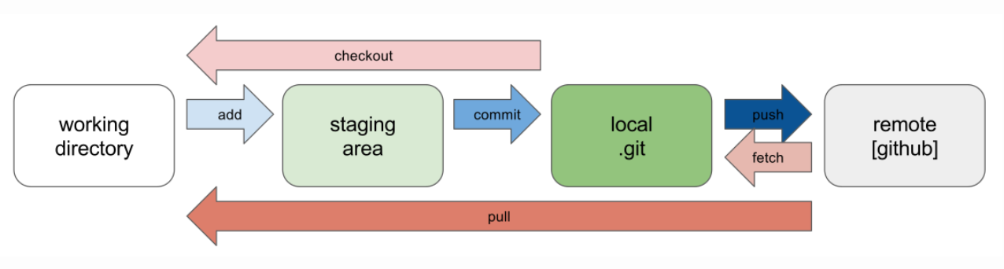
Basic Workflow of Git (Git Commands):
Before we dive deep into the work flow and commands of Git, it is pertinent to define what a repository is. A Repository (or a repo) is a directory or storage space where your projects can live. It can be local to a folder on your computer, or it can be a storage space on other online hosts (such as GitHub). You can keep code files, text files or image files inside a repository. Think of a repository as a kind of database where your VCS stores all the versions and metadata that accumulate in the course of your project. In Git, the repository is just a simple hidden folder named ".git" in the root directory of your project. Knowing that this folder exists is more than enough. You don't have to (and, moreover, should not) touch anything inside this magical folder. When you're starting to use version control with Git, you first need to understand the "big picture". Before getting your head around any specific commands, you should make sure you’ve grasped the general concepts: What does a workflow look like? Which steps are involved? What do they do?

Slide 10
Basic Workflow of Git (Git Commands):
Getting such a repository on your local machine can be done in two ways: If you have a project locally on your computer that is not yet under version control, you can initialize a new repository for this project. If you're getting on board of a project that's already running, chances are there is a repository on a remote server (on the internet or on your local network). You'll then probably be provided with a URL to this repository that you will then "clone" (download / copy) to your local computer. As soon as you have a local repository, you can start working on your files: modify, delete, add, copy, rename, or move files in whatever application (your favorite editor, a file browser, ...) you prefer. In this step, you don't have to watch out for anything. Just make any changes necessary to move your project forward. It's only when you feel you've reached a noteworthy state that you have to consider version control again. Then it's time to wrap up your changes in a commit. However, before you commit, you'll want to get an overview of what you've changed so far. In Git, you'll use the "status" command to get a list of all the changes you performed since the last commit: which files did you change? Did you create any new ones or deleted some old ones? Next, you tell Git which of your local changes you want to wrap up in the next commit. Only because a file was changed doesn't mean it will be part of the next commit! Instead, you have to explicitly decide which changes you want to include. To do this, you add them to the so-called "Staging Area". Now, having added some changes to the Staging Area, it's time to actually commit these changes. You'll have to add a short and meaningful message that describes what you actually did. The commit will then be recorded in your local Git repository, marking a new version of your project. From time to time, you'll want to have a look at what happened in the project - especially if you're working together with other people. The "log" command lists all the commits that were saved in chronological order. This allows you to see which changes were made in detail and helps you comprehend how the project evolved. Also when collaborating with others, you'll both want to share (some of) your changes with them and receive the changes they made. A remote repository on a server is used to make this exchange possible.

Slide 11
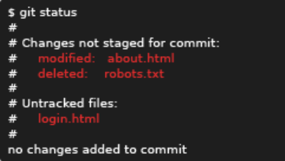
Basic Workflow of Git (Git Commands):
Lets’ see some commands that help us achieve the basic workflow just explained above. git init – starting a new project $ git init Executing the git init command in the root directory/folder of your project creates a new and empty Git repository. Once done, you are ready to start getting your files under this version control. git clone – working on an existing project $ git clone https://github.com/my_project/gitproject.git The git clone command is used to download a copy of an existing repository from a remote server such as Github. When this is done, you have a full-featured version of the project on your local computer – including its complete history of changes. git status – keep the overview
The git status commands tells you what happened since the last commit: which files did you change? Did you create any new ones or deleted old ones?

Slide 12
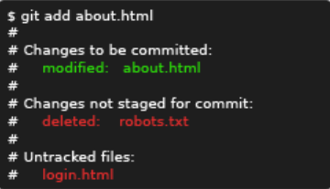

Basic Workflow of Git (Git Commands):
git add <filename> - Add files to the ‘Staging Area’
Only because a file was changed doesn’t mean it will be part of the next commit. Instead, you will have to explicitly decide which changes you want to include. To do this, you add them to the so-called ‘Staging Area’ with ‘git add’ command.
git commit -m message – Commit all staged changes
We changed a file, we added it to the staging area, and now we are ready to take a snapshot storing away these changes forever! Let’s commit!
Each commit records a snapshot of the state of the full repository along with the name, timestamp, and message of the committer. A message is required! It is your note to posterity so you can remember why you made changes in the future.

Slide 13
Basic Workflow of Git (Git Commands):
git push – pushing changes on server $ git push origin master Git Push Origin Master pushes your master branch to the origin. Primarily, git push command is used to upload local repository content to a remote repository. Pushing is how you transfer commits from your local repository to a remote repo. Push sends only the changes, so it is very efficient network use.
git pull – pulling changes from server
git pull is a Git command used to update the local version of a repository from a remote. By default, git pull does two things.
Updates the current local working branch (currently checked out branch)
Updates the remote tracking branches for all other branches.
git pull fetches (git fetch) the new commits and merges (git merge) these into your local branch. Use git pull to update a local repository from the corresponding remote repository. For example, while working locally on master, execute git pull to update the local copy of master and update the other remote tracking branches.
For more Git commands, refer to this Git documentation.

Slide 14
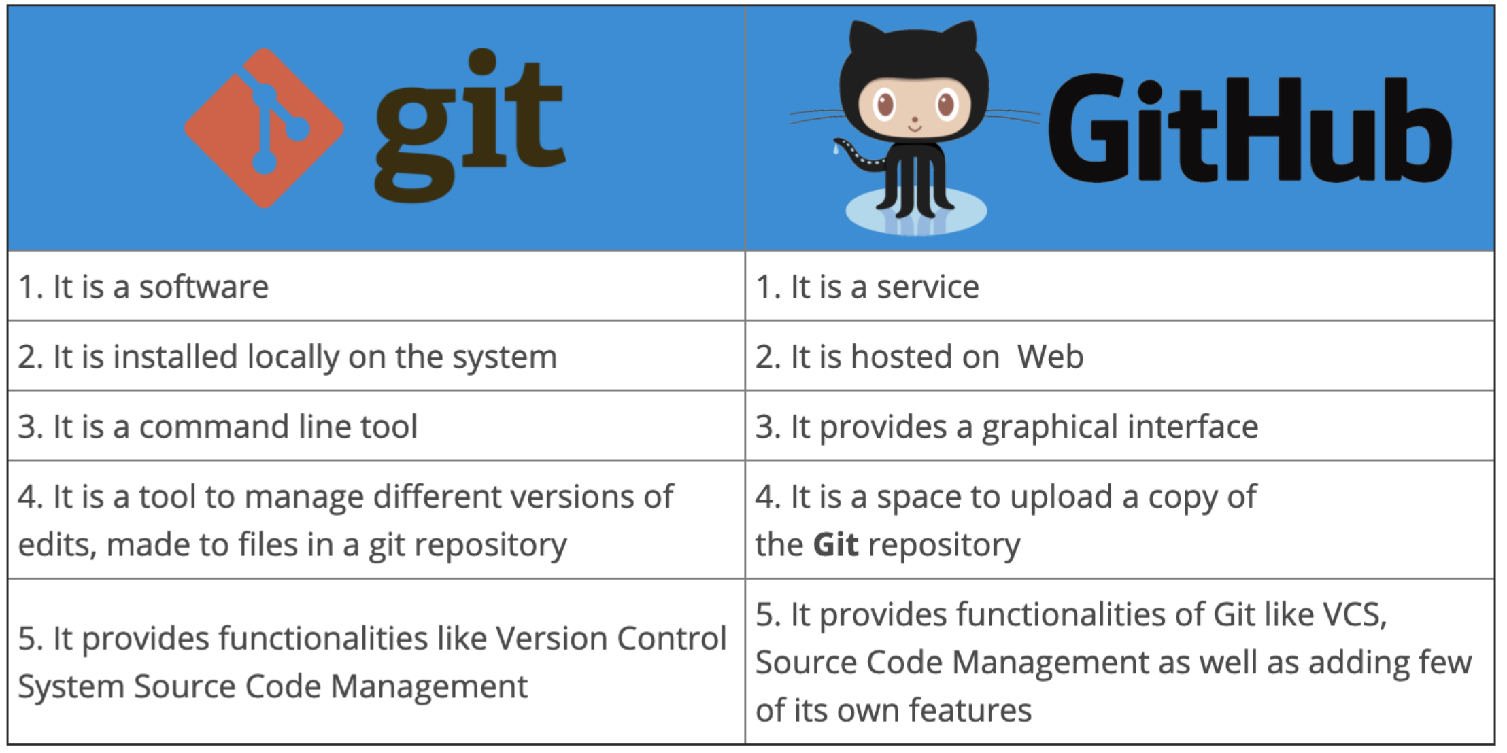
GitHub and Creating Account on GitHub:
GitHub is an online software development platform used for storing, tracking, and collaborating on software projects based on Git. It enables developers to upload their own code files and to collaborate with fellow developers on open-source projects. GitHub also serves as a social networking site in which developers can openly network, collaborate, and pitch their work. GitHub’s interface is user-friendly enough so even novice coders can take advantage of Git. Without GitHub, using Git generally requires a bit more technical savvy and use of the command line. GitHub is so user-friendly, though, that some people even use GitHub to manage other types of projects – like writing books.
GitHub has other competitors in the market such as GitLab, BitBucket, and Visual Studio Team Foundation Server etc. So what makes GitHub more popular among its competitors is:
Immensely powerfully communities – Github is used by more than 73 million developers around the globe.
The largest shared repository – More than 200 million repositories
Easy version control
Secure Cloud Service
GitHub is number one platform of choice of developers from varies large corporations. Microsoft being biggest contributor to that count. Google, SAP, Airbnb, PayPal and many other are also contributor to it. It provides easiest version control system in the market, enhancing reliability and productivity.
Most software projects have bug trackers of some kind. GitHub tracker is called Issues and has its very own section in every repository. It is a great way to keep track of tasks, enhancements and bugs for your projects.
Most people confuse Git and GitHub and often use interchangeably. Difference between Git and GitHub are as follow:

Slide 15
GitHub and Creating Account on GitHub:
Set up an account on GitHub
There are two versions of GitHub: one is Desktop version and other is Web-based. We will use Web-based version to setup our GitHub account.
Go to https://www.github.com/
On the right top corner, click on Sign Up button.
After that, provide your valid email address, password and desired username
You will be asked to solve a puzzle similar in spirit to Google Captcha for verifying that you are a human.
Once all the required fields are filled, Create Account button will appear. Click the Create Account
On next step, a confirmation code will be sent your inputted email, once you enter that number; your GitHub account will be activated.

Slide 16
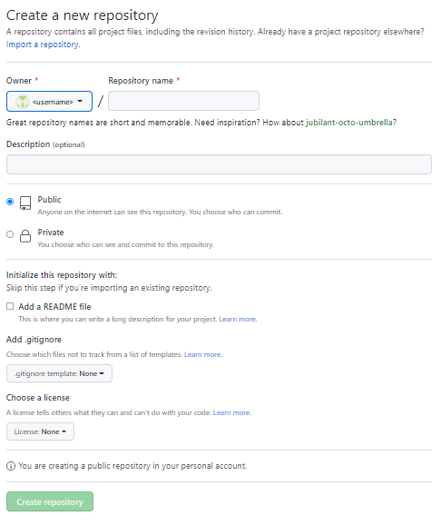
Creating new GitHub Repository:
With your newly created GitHub account signed in, you will find ‘Create repository’ button on right side of the page. Click the button.
On next screen, you will find page similar to attached one. Lets’ explore each and every field of this page to be filled.
First inputs are Owner and Repository name
Owner will be your username
Repository name is where you will enter name of desired repository in which your code and other files will reside.
Next input field is Description (optional). This is where you can write a short message describing the contents of the repository.
Next come two radio buttons; one for making your repository Public that anyone can have access to that repository and other for Private, for reserved access.
Now there is a checkbox for Add a README file. README.md file may contain all the project related details such as elaborated description, dependencies, limitations etc.
If you are not cloning an existing repository, you may want to add a .gitignore file. Not always you want to push all the file of your project to the repository. You can write the name of the file in .gitignore file and while pushing your project to the repository, Git will ignore those files.
Last one is Choose a license, with right license you tell other how to your code should be used and what are the restrictions defined.
Once all the required fields are filled, click the Create repository button to create a repository in your personal account.

Slide 17
Closing (2 mins)

